Slide 1

Agile Performance Monitoring
& Continuous Improvement: Part 2
Shifting the focus from “did you hit this goal or KPI” to “how do we support you in getting to the next goal” through Continuous Improvement Strategies
Version: Draft 0.2
Author: Jonathan Howell
Date: 27/11/2018

Slide 2
It’s all about dynamics / and encouraging / fostering!
Remember this from Deck 1?
Transparency
Trust and Autonomy
Safe environment to experiment
ROI is important but not the only factor
Continuous Improvements are actually more important!
Given the time between setting goals and then evaluating their success,
do we really expect periodic objectives for employees to be effective?

Slide 3
What Are the Pitfalls?
Context is king -
Potential Measures/KPIs
Cycle Times --> elaboration time, Build and Local Dev, Integration Time
Release Number--> No of features (small, medium, large) over a period of 3 months
No. of Bug --> no of bugs in a product (p1, p2 ,p3)
Technical Debt --> no. of technical debt items in a product
Mean Time To Restore Service
Mean Time To resolve
Potential Problems
Cycle Times --> I will avoid complex or legacy work.
I will game this data by delivering small items of low or no value.
I won’t record them any more, and if you use incidents I won’t take them into my team – the sister team can have it!
This can be inherited or even resultant from entropy!
I didn’t break it – but you track me on resolution? (Same for 6)
You no longer trust me, I am not going to tell you what we are doing and I don’t feel safe!

Slide 4
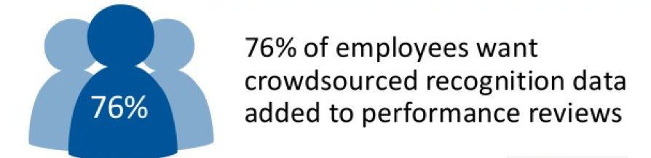
Remember this from Deck 1?
Managers are commonly cited as the primary reason why employee chose to leave their jobs!
When establishing Agile Performance Management:
Review frequently
Negotiate objectives and expectation (employees at all levels, not just middle management & above)
Establish feedback loops via crowdsourcing
Enabling individuals to give and receive recognition freely is fundamental to successful Agile Performance Management
Agile Performance Management focuses on people as much as the end goals, striving for continuous improvement and real time understanding of employee opinions, issues or concerns.

Slide 5
The alterative
Transparency / Trust & Autonomy / Safe Environments to Experiment / Continuous Improvement & ROI
70% of time is spent in initiatives – so 70% of bonus should be monitor this way
30% of time is spent in Technical Investments (50:50) and so we should REWARD this way
70% Initiative
  Was the ask realistic?
  Was it aggressive / difficult to achieve?
  Did we achieve it?
  Did we release / realise Value?
This is a team metric that should be not be based solely on delivery.
It should be effort, complexity and delivery based.
(we all like to work in shiny new things but some of us need
to keep the show on the road).
30% Technical Investment
  How do you want to improve yourself
  Have you achieved your goal?
  What have you done to
  progress the company goals & vision?
  Where have you made a difference?
This is about personal development,
and continuous improvement.
And improving the working environment.
ROI is important but not the only factor Continuous Improvements are actually more important!
Don’t game the stats or filter trust, rather encourage improvement and personal development.

Slide 6
The Bonus
Incentivise, Recognise and Reward – not carrot and stick!
70%
With Autonomy comes Accountability
30%
What are you doing to make this a better place?
How are you aiming to make yourself better?
Our Company, Our Culture, our Family!

